Slide 1
NBA Player Statistical Data Analysis
Tim Chen, Ying Jiang, Mohamed Alshamsi

Slide 2
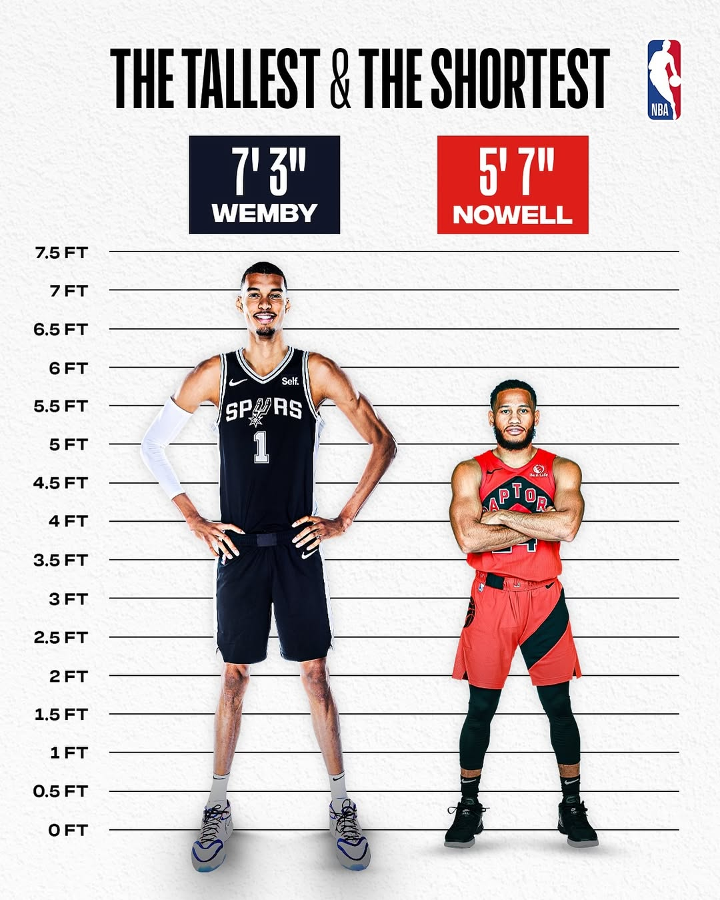
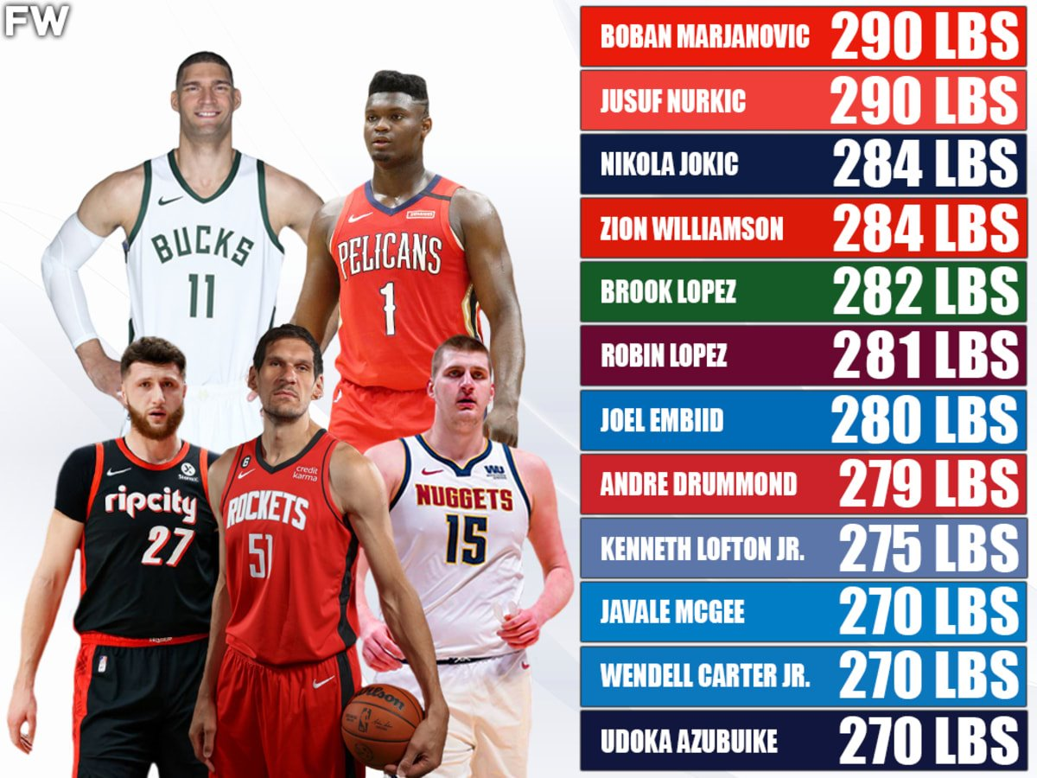
Exploring
We’re analyzing how physical traits like height and weight relate to NBA draft results.
We used data from Kaggle + NBA.com, combining player profiles with draft outcomes.
Our main question was: Are certain physical traits more common among higher draft picks?

Slide 3

Challenge
Height data was recorded like “6-7”, which we had to split and convert.
Some weights were missing or not numbers even which we had to fill with median values.
Merging the datasets by person_id took trial and error.

Slide 4
Insights

Slide 5
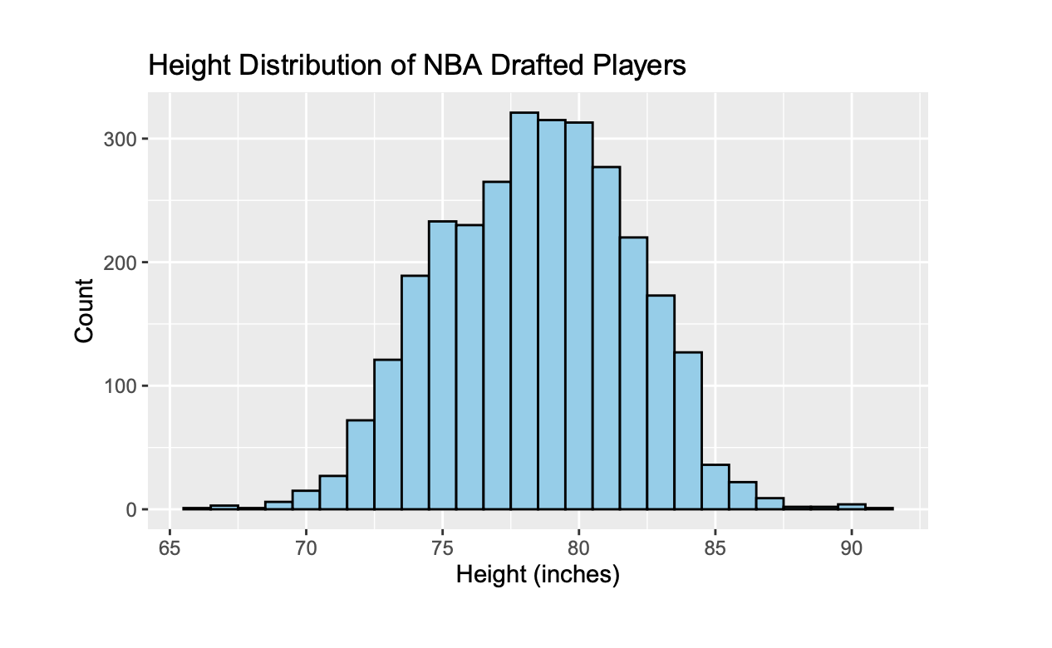
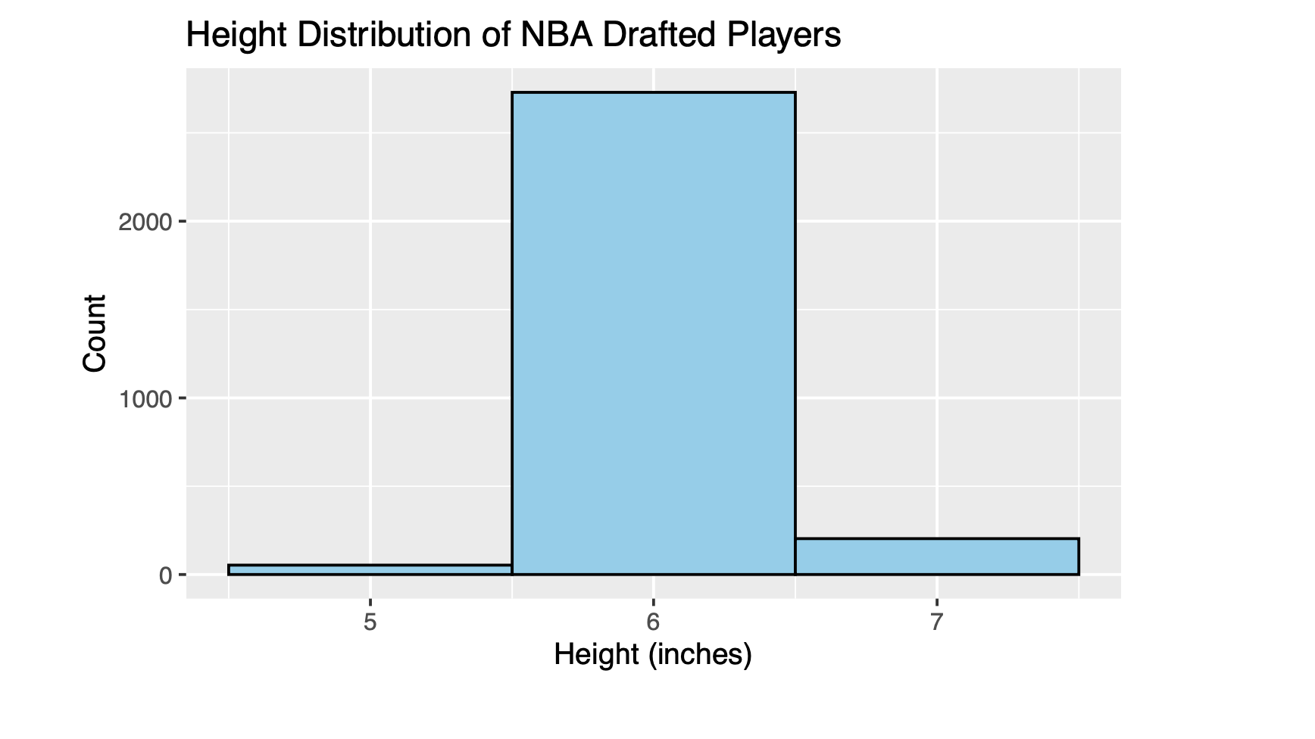
Height Distribution

Slide 6
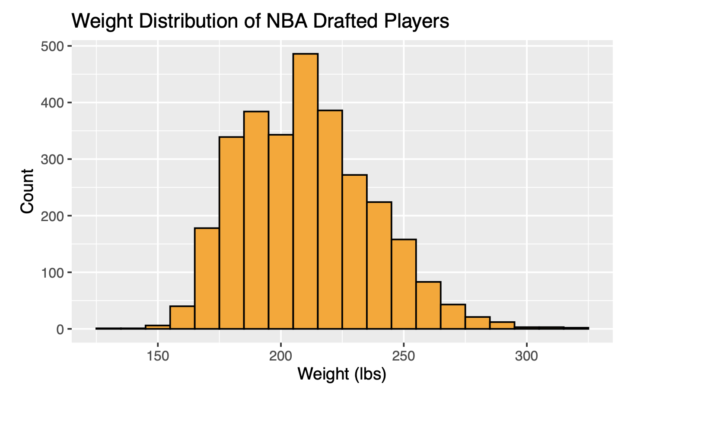
Weight Distribution

Slide 7
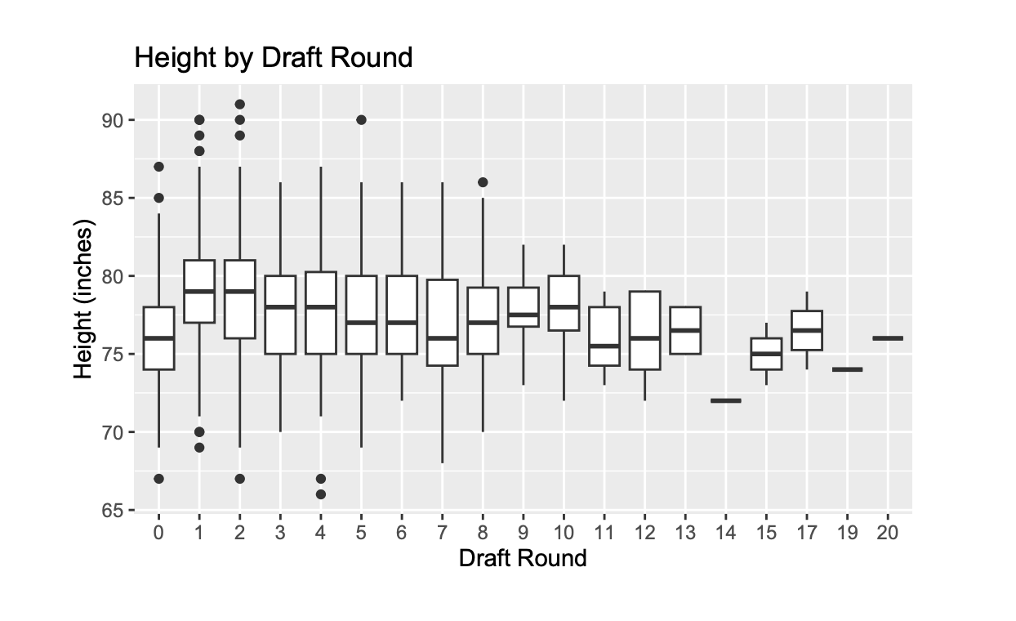
Draft Round vs Height

Slide 8
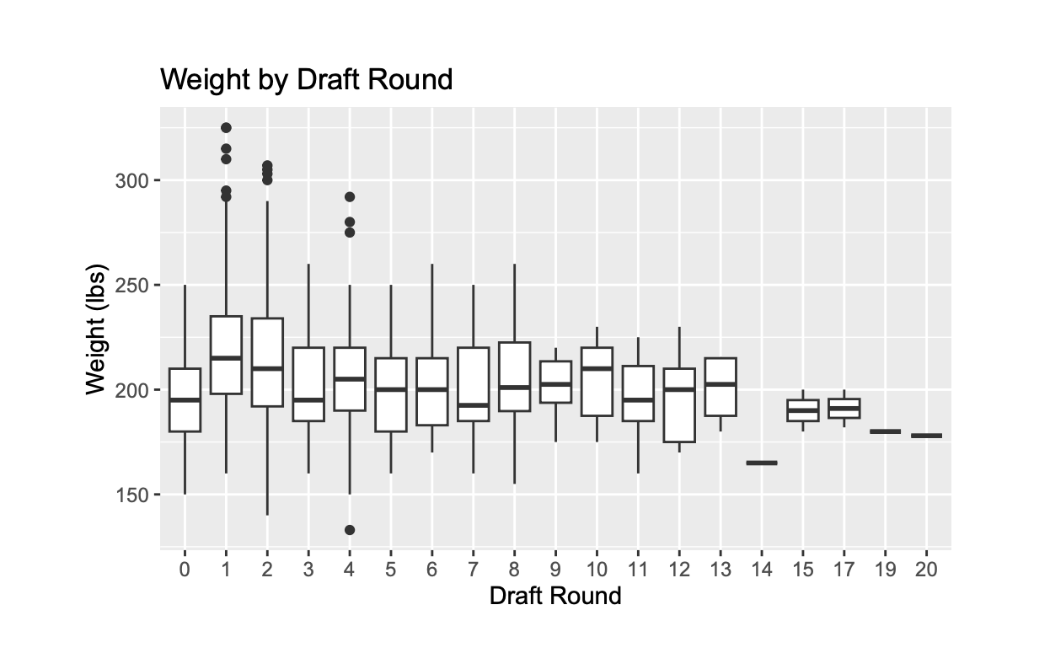
Draft Round vs Weight

